Slide 1
Solutions Investigation
Year 7 Science

Slide 2
Review
What does dissolved mean?
Which dissolves which (solvent and solute)
Solutions are special types of mixtures that are
U………….. and T……………………..

Slide 3
Learning Intentions
Mixtures, including solutions, contain a combination of pure substances that can be separated using a range of techniques.

Slide 4
Success criteria
Identify the question to be investigated.
Write a prediction.
Identify the variables that you will change, measure and keep the same.
Collect some results.

Slide 5
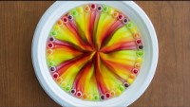

Slide 6
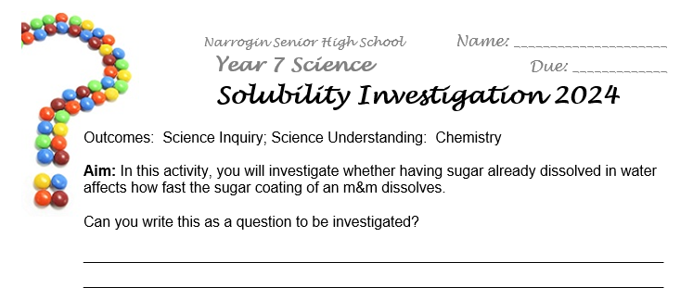
Solubility Investigation (5%)

Slide 7
